Slide 1
“Explore The Trades Skills Lab,
Built by Ferguson”

Slide 2
Today’s Topics
Who We Are: Explore The Trades
Eligibility: Who can apply?
Timeline: What is the timeline for this program?
Equipment: What is the process to order equipment?
Reporting: What is the follow-up for the program?
Current Instructors: Hear from current Skills Lab instructors.

Slide 3
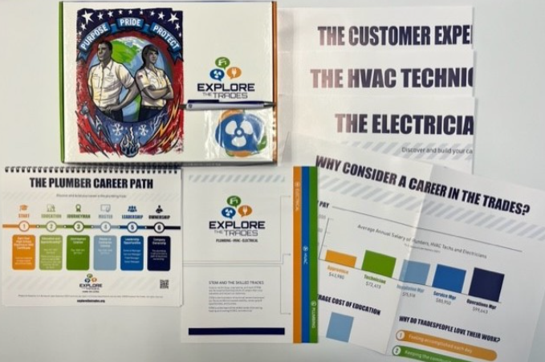
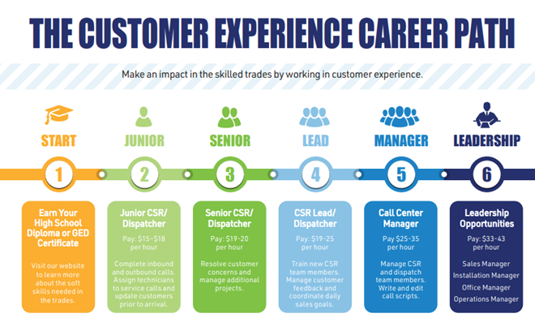
About Explore The Trades
To bridge the technical talent gap to the service trades of plumbing, heating, cooling, and electrical.

Slide 4
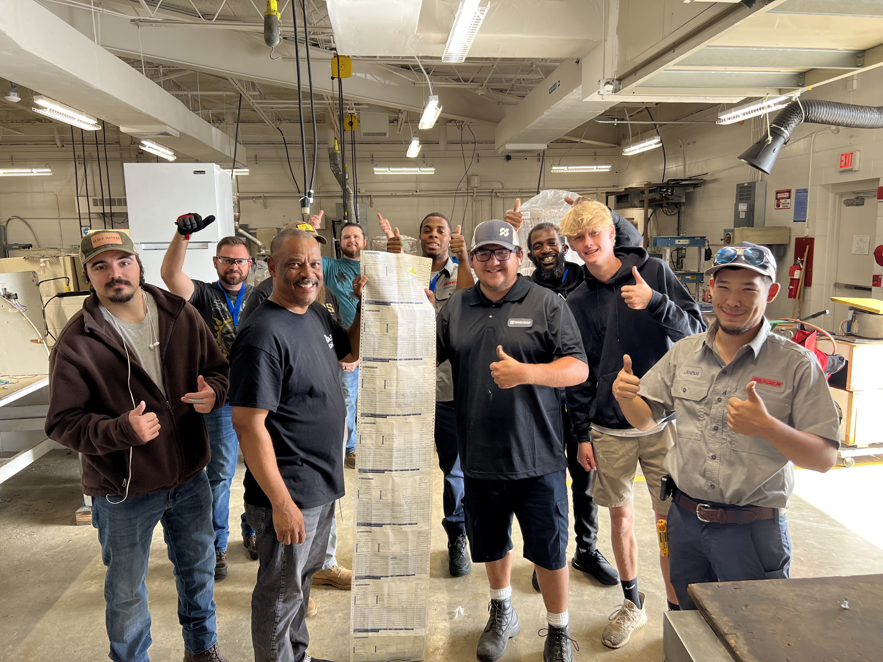
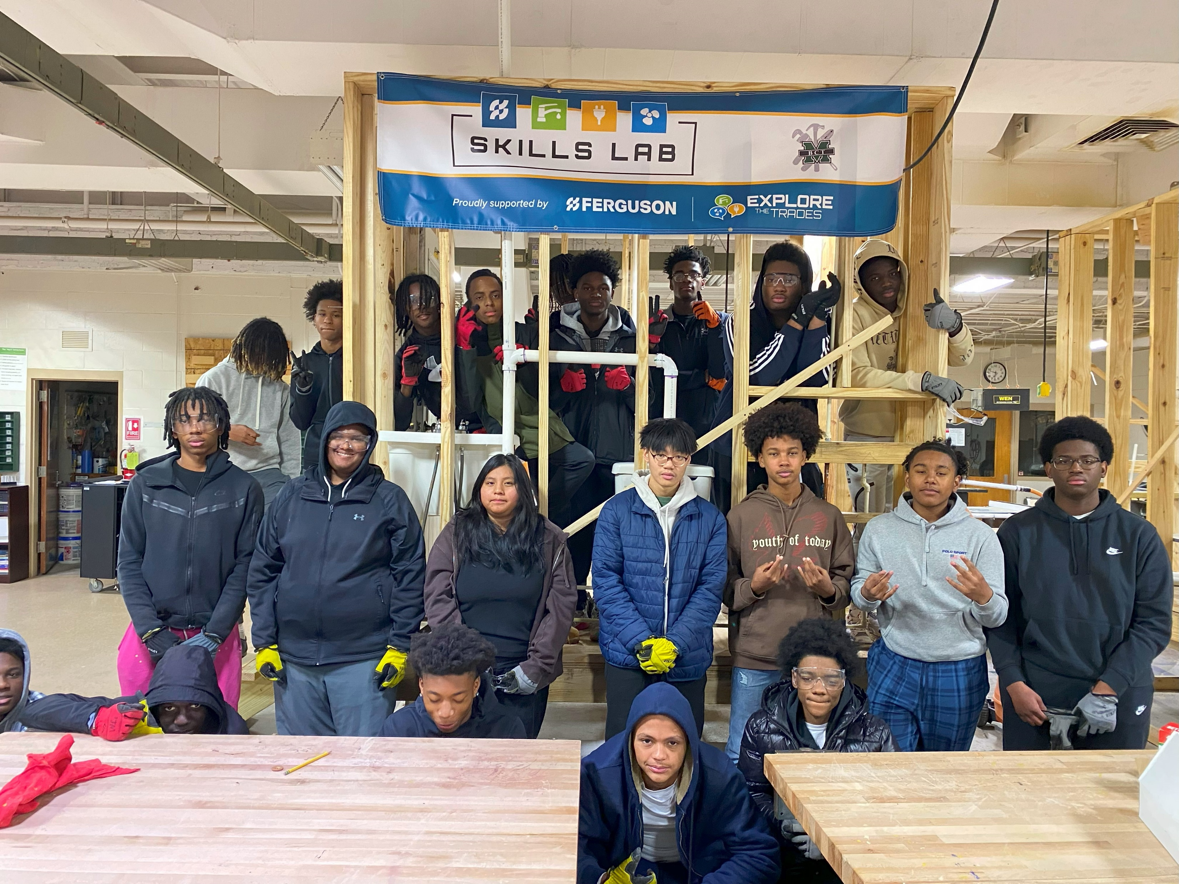
About the Skills Lab Program
Explore The Trades and Ferguson partnered in 2021 to bring the skilled trades back into the classroom.
Since 2021, over 1,100 students at 14 schools throughout the U.S. have started their trades education through the Skills Lab program.

Slide 5
Skills Lab Recipients
2021-2022 Skills Lab Recipients
Byron Martin Advanced Technology Center – Plumbing (TX)
Washburn Tech – Plumbing (KS)
Haney Technical College – HVAC (FL)
2022-2023 Skills Lab Recipients
Bronx Design & Construction High School – Plumbing (NY)
Carroll Co. Career & Technical Center – HVAC (MD)
Franklin Co. High School – Plumbing (VA)
Hastings High School – Plumbing (MI)
Lyman High School – Plumbing (FL)
Milford Mill Academy – Plumbing (MD)
Milford Mill Academy – Plumbing (MD)
Roxbury High School – Plumbing (NJ)
Somerset Co. Tech. High School – HVAC (MD)
SVHEC Career Tech Academy – HVAC (VA)
West Lincoln Middle School – Plumbing (NC)
Western School of Tech & Env. Science – Plumbing (MD)

Slide 6
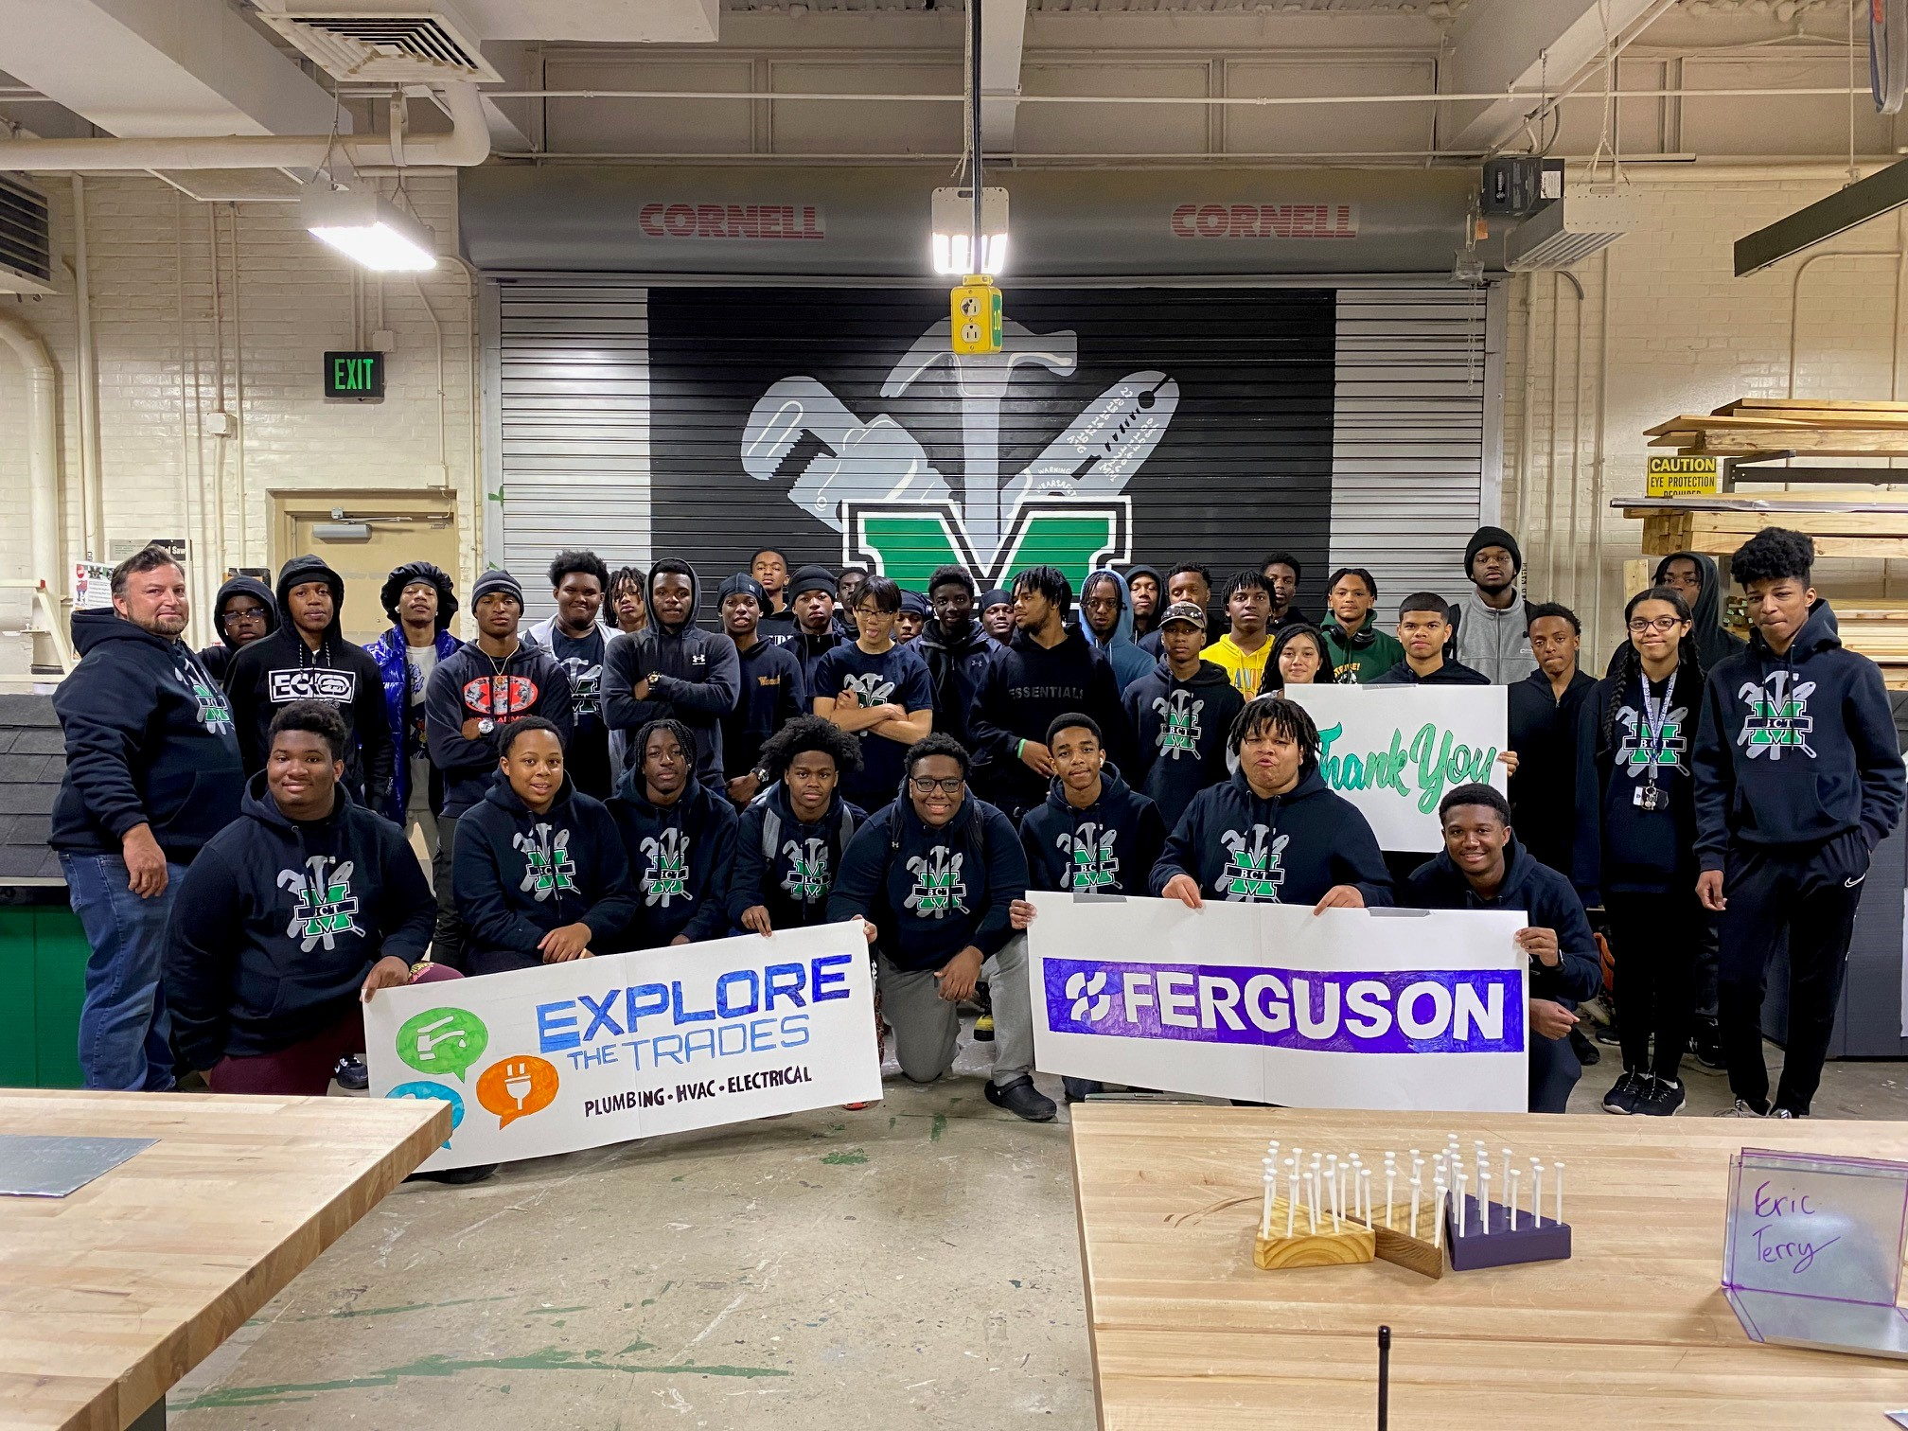
Eligibility
Middle schools and high schools (grades 6-12) are eligible to apply.
Includes public, private, CTE, or charter schools.
Schools that have received a Skills Lab award within the past 24 months are not eligible to receive funding.

Slide 7
Application Types
New Skills Lab
No existing plumbing or HVAC equipment or education.
Refurbished Skills Lab Application
Existing plumbing or HVAC training space.
The amount of new vs. refurbished labs is directly proportional to the number of applications.
Applications
Emailed to maddys@explorethetrades.org
Accessed: https://explorethetrades.org/explore-the-trades-skills-lab/

Slide 8
Timeline and Dates
March 31 - Applications close
May 1 - Recipients announced
July 31 - Order skills lab equipment
September -December – Skills Lab is finished
Finished Skills Lab
April -
Applications reviewed
May – June
Work with local Ferguson contact

Slide 9
Equipment Order and Payment
Schools will work with their Ferguson store to select equipment.
Once the final order is ready, your Ferguson contact will send it to Explore The Trades for final approval.
Once the order has been approved, Explore The Trades will complete the purchase process with the respective Ferguson branch.
Schools are not responsible for any transactions.
School will coordinate delivery with their Ferguson branch.

Slide 10
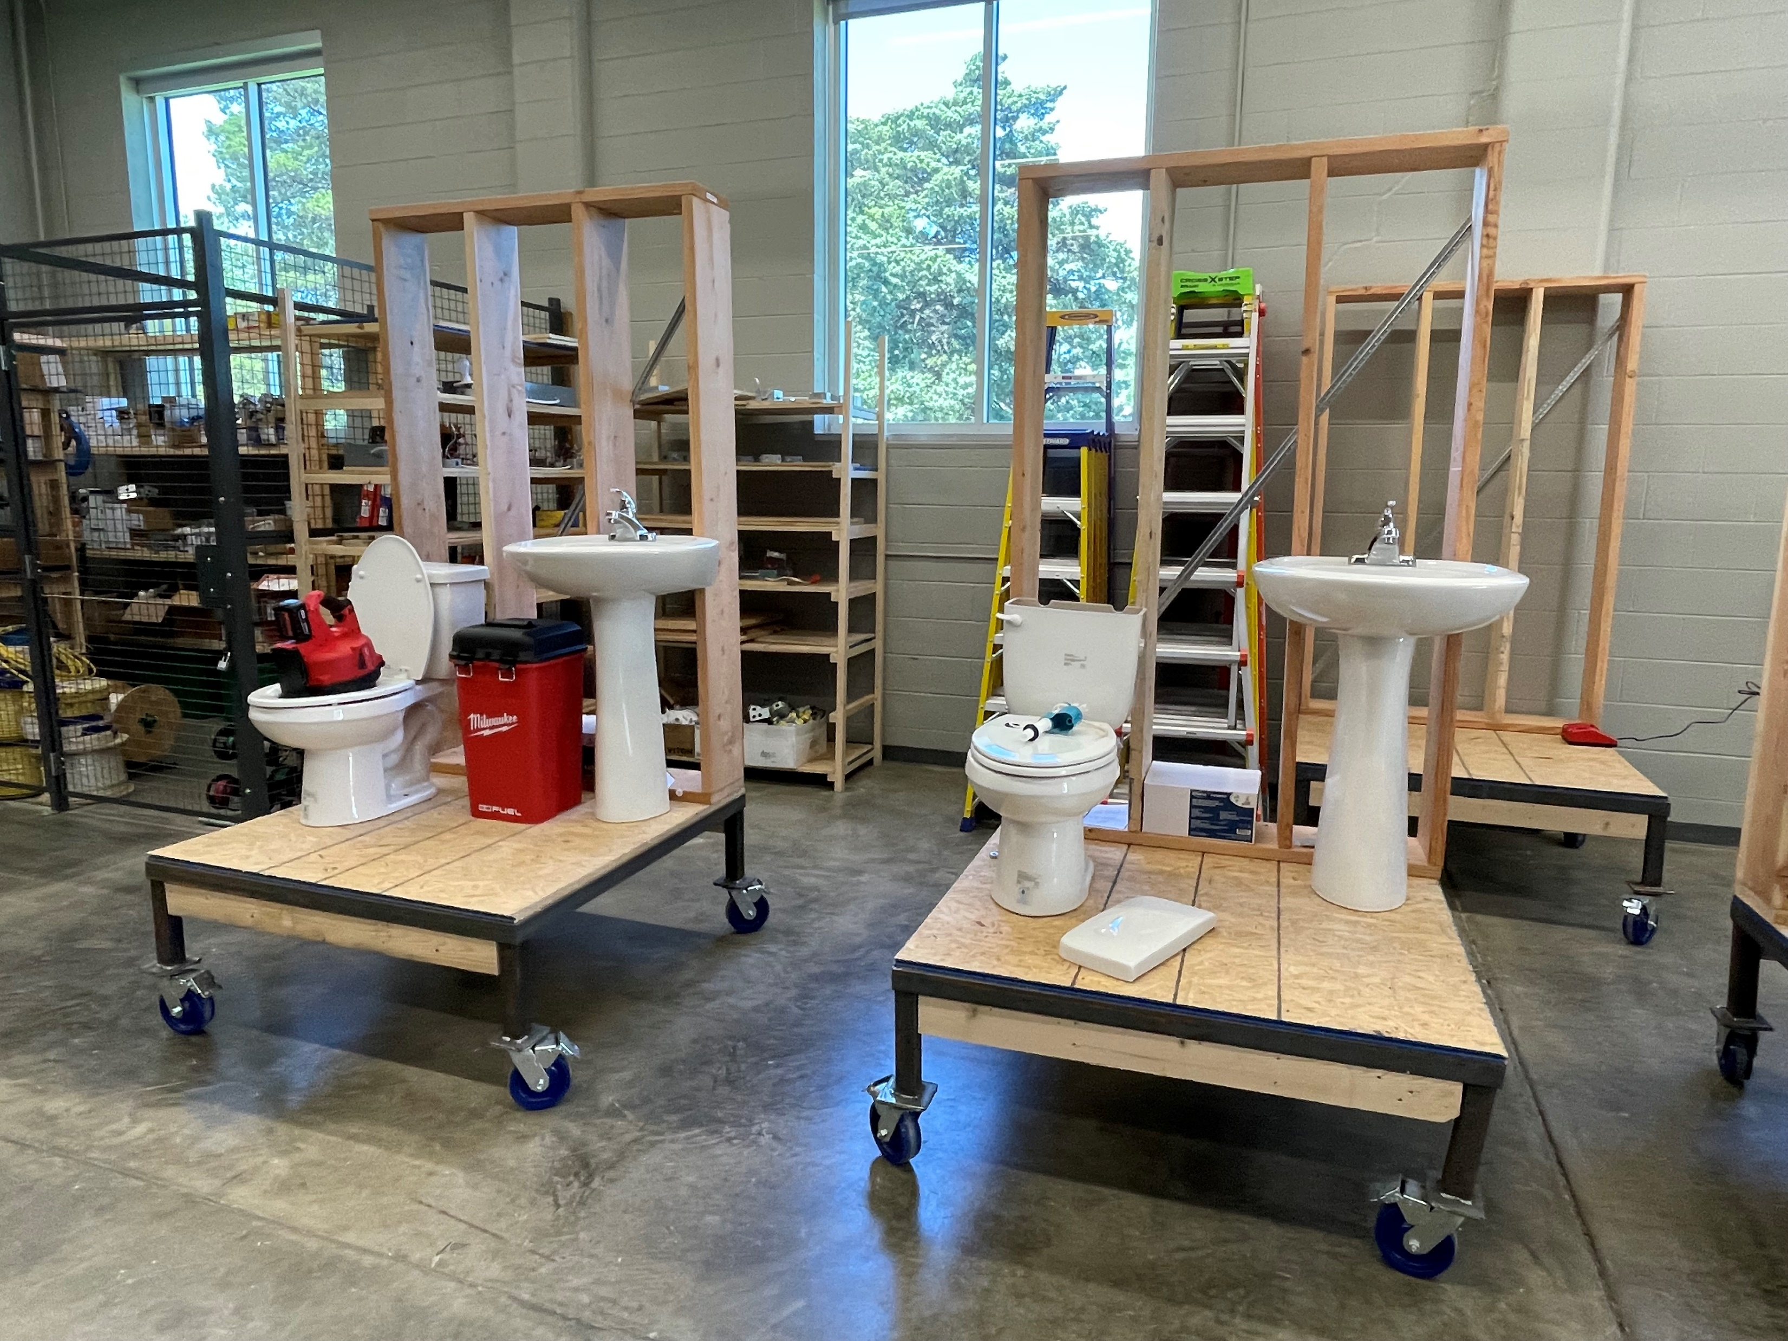
Equipment Order and Payment
Schools may select a variety of different materials for their Skills Lab.
Schools will work with their Ferguson contact to select items and arrange delivery.
Schools may use up to 10% of their final award to purchase materials that may not be available through Ferguson.

Slide 11
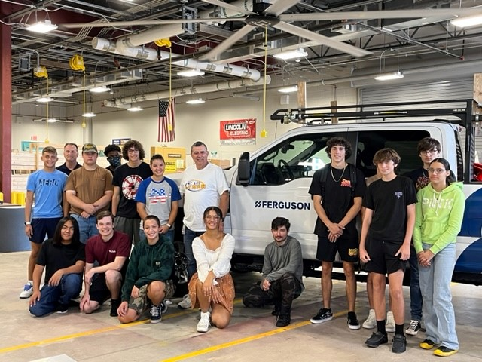
Additional Program Details
This program does not manage, or provide, curriculum or instructors to school recipients.
Schools are responsible for both in accordance with school district or Dept. of Education requirements.

Slide 12
Follow-Up Reporting
Recipients can expect to provide success metrics up to three times during the academic year.
Reporting will include:
Student enrollment in class
Student success rate for completing tasks and skills
Student placement in apprenticeship programs
Reporting metrics will be emailed to instructors throughout the year:
October 2024
January 2025
May 2025
*Site visits (in-person) or virtual may be requested, if scheduling permits.

Slide 13
Skills Lab Instructors
Thank you to our current Skills Lab instructors for joining us!
Ricky Martinez, Byron Martin Advanced Technology Center, Plumbing Instructor.
Curtis Bumgardner, Franklin County High School, Supervisor of CTE.
Troy Slattery, Western School of Technology & Environmental Science, Plumbing Instructor.

Slide 14
Questions

Slide 15
Contact Information
Toni Bower
Donor Engagement Specialist
tonib@explorethetrades.org
651-300-1612
Kate Cinnamo
Executive Director
katec@explorethetrades.org
651-789-8518
Maddy Sorenson
Project Coordinator
maddys@explorethetrades.org
651-314-3856
www.explorethetrades.org

