Slide 1

Introduction to
ELECTRICAL

Slide 2
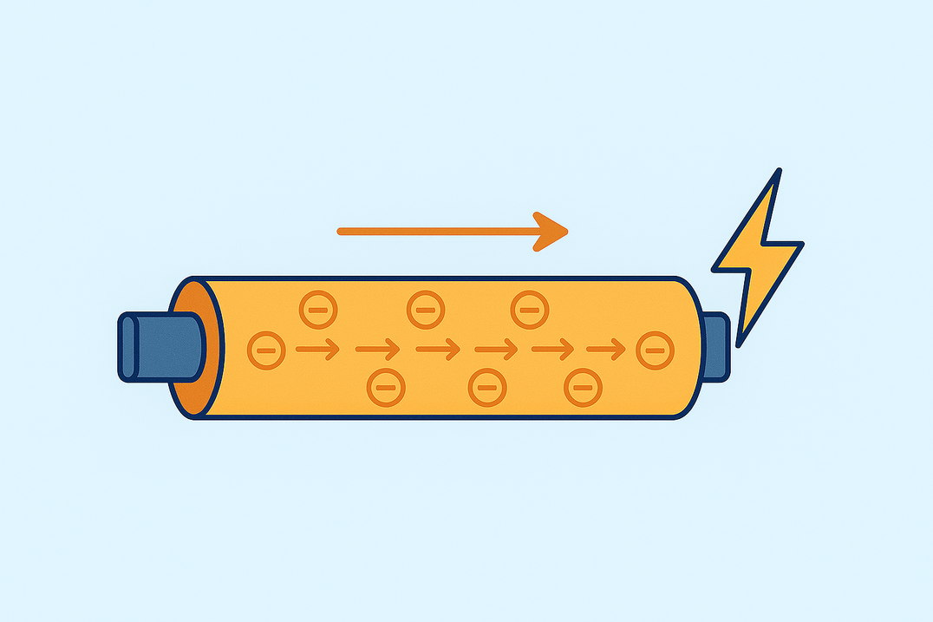
WHAT IS ELECTRICITY?
It is the flow of electric charge through a conductor, used to power devices and systems.
© 2026 Explore The Trades. All rights reserved.

Slide 3
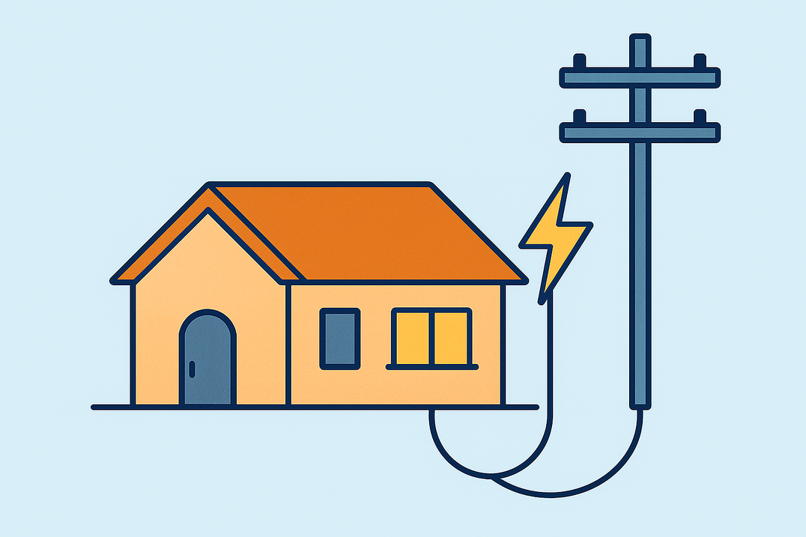
WHERE DO WE SEE ELECTRICITY IN EVERYDAY LIFE?
  Homes
  Schools
  Hospitals
  Stores
  Restaurants
© 2026 Explore The Trades. All rights reserved.

Slide 4
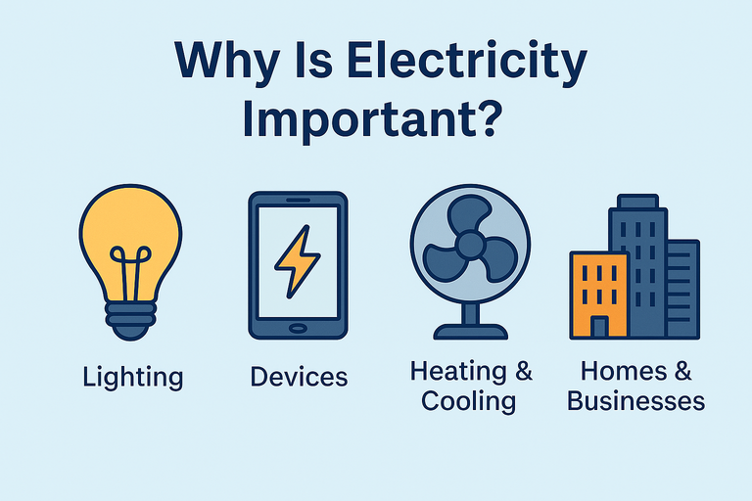
WHY IS ELECTRICITY IMPORTANT?
  It powers things like lights, phones, and computers.
  Runs appliances like refrigerators and TVs.
© 2026 Explore The Trades. All rights reserved.

Slide 5

APPRENTICESHIPS AND TRADE SCHOOL
After high school and at 18 years old, you can enter an apprenticeship program or go to trade school.
Apprenticeships combine classroom learning with hands-on experience, while trade school is a more traditional classroom setting.
After completing your training, you can earn a license and start working as a professional electrician!
© 2026 Explore The Trades. All rights reserved.

Slide 6
WHAT CLASSES PREPARE YOU FOR A CAREER IN ELECTRICITY?
Math: Electricians rely on math every day to:
  Apply formulas like Ohm’s Law to solve electrical equations
  Read blueprints
  Interpret spatial layouts
  Measure angles and distances for precise installations
  Work with alternating current (AC) circuit
  Calculate load requirements and phase angles to ensure safe and efficient systems
© 2026 Explore The Trades. All rights reserved.

Slide 7
WHAT CLASSES PREPARE YOU FOR A CAREER IN ELECTRICITY?
Physics: Electricians rely on physics every day to:
  Understand electricity and magnetism
  Understand the basics of electric charge, current, voltage, and resistances
  Understand how electrical energy flows through wires and how magnetic fields are created
© 2026 Explore The Trades. All rights reserved.

Slide 8
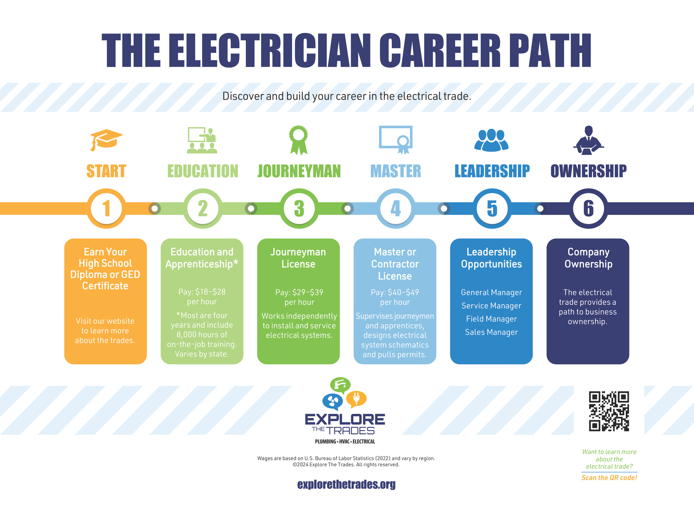
CAREER PATHWAYS
© 2026 Explore The Trades. All rights reserved.

Slide 9

TYPES OF EMPLOYMENT
  Businesses that focus on residential homes
  Businesses that focus on commercial buildings
  Hospitals
  School systems
  Universities & colleges
  Factories & warehouses
  Data centers
© 2026 Explore The Trades. All rights reserved.

Slide 10

WHERE DO ELECTRICIANS WORK?
Indoors:
  Installing and repairing wiring, outlets, and lighting.
Outdoors:
  Working on street lights, solar panels, and outdoor electrical boxes.
© 2026 Explore The Trades. All rights reserved.

Slide 11

PAY
  Pay varies by location and by experience
  The average starting wage is between $18 to $28 per hour (U.S. Bureau of Labor Statistics, 2024)
© 2026 Explore The Trades. All rights reserved.

Slide 12

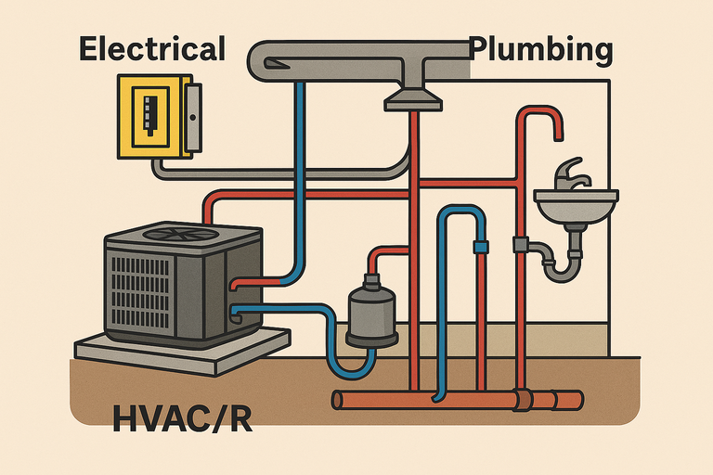
DID YOU KNOW?
Did you know that electrical systems, HVAC/R, and plumbing often work together?
HVAC/R units need electricity to run fans and compressors, and plumbing systems sometimes use electric pumps for water flow. Understanding how these systems connects makes electricians valuable on construction and maintenance teams.
There are so many exciting options waiting for you in the trades!
© 2026 Explore The Trades. All rights reserved.

Slide 13






WANT TO LEARN MORE?
Check out our website, follow us on social media, or take our quiz today to see which trade fits you best
www.explorethetrades.org
Follow us on social media @explorethetrades

