Slide 1

Introduction to
PLUMBING

Slide 2
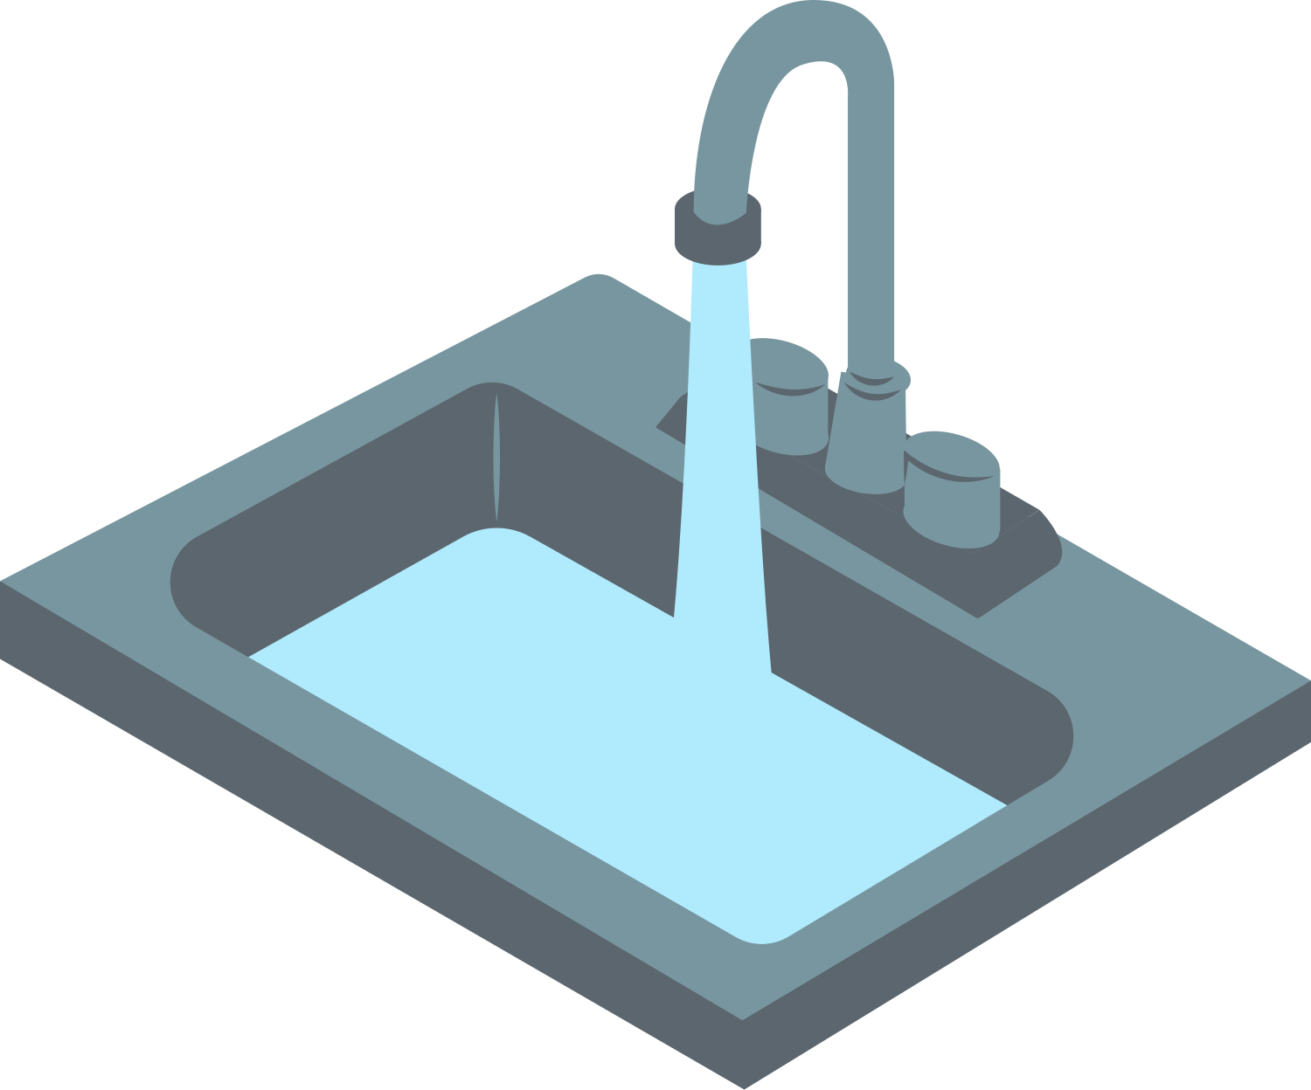
WHAT IS PLUMBING?
Plumbing works to bring clean water in and push dirty water out of a building.
Plumbers fix and install plumbing systems in homes, schools, and businesses.
© 2026 Explore The Trades. All rights reserved.

Slide 3
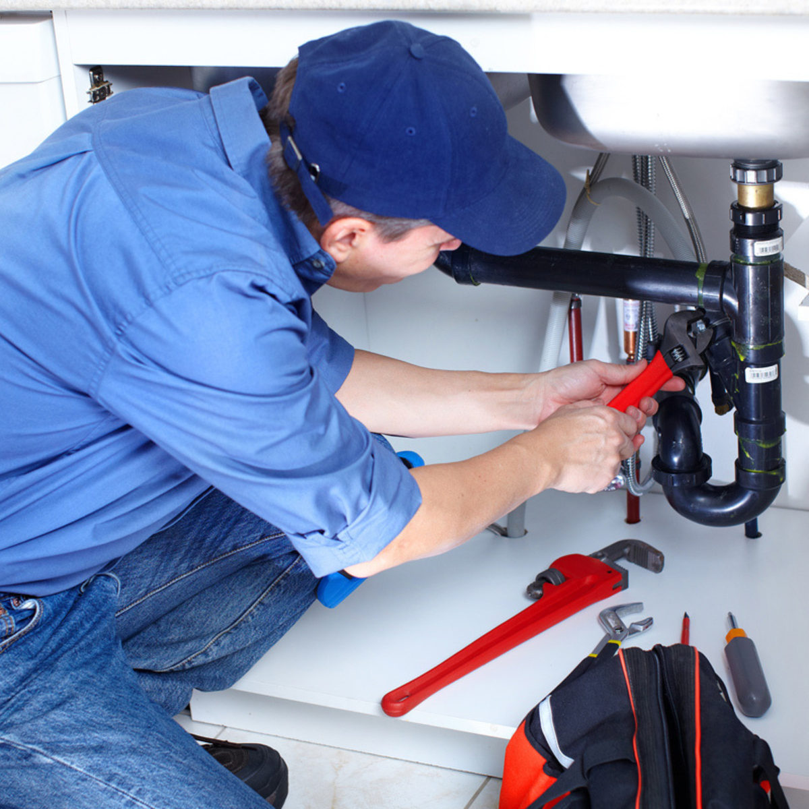
WHERE DO WE SEE PLUMBING IN DAILY LIFE?
  Homes
  Schools
  Hospitals
  Stores
  Restaurants
© 2026 Explore The Trades. All rights reserved.

Slide 4

WHY IS PLUMBING IMPORTANT?
  Protects public health
  Supports every day life
  Protects the environment
© 2026 Explore The Trades. All rights reserved.

Slide 5
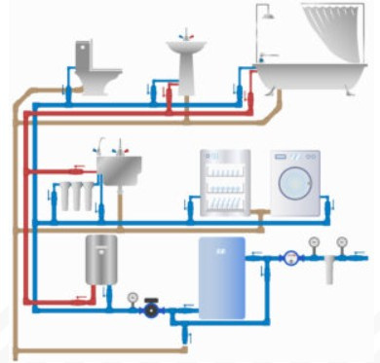
WHY DO WE NEED PLUMBING?
Clean Water: Plumbing delivers clean water to homes, schools, and buildings, ensuring safe drinking water, proper handwashing, and overall health.
Waste Removal: Plumbing takes dirty water and waste away from buildings, keeping spaces clean and preventing the spread of germs and disease.
Comfort: Plumbing enables access to hot showers, flushing toilets, and the use of sinks and dishwashers.
Planet Protection: Plumbing helps save water and energy. Plumbers install water-saving devices and fix leaks, which help protect the environment.
© 2026 Explore The Trades. All rights reserved.

Slide 6
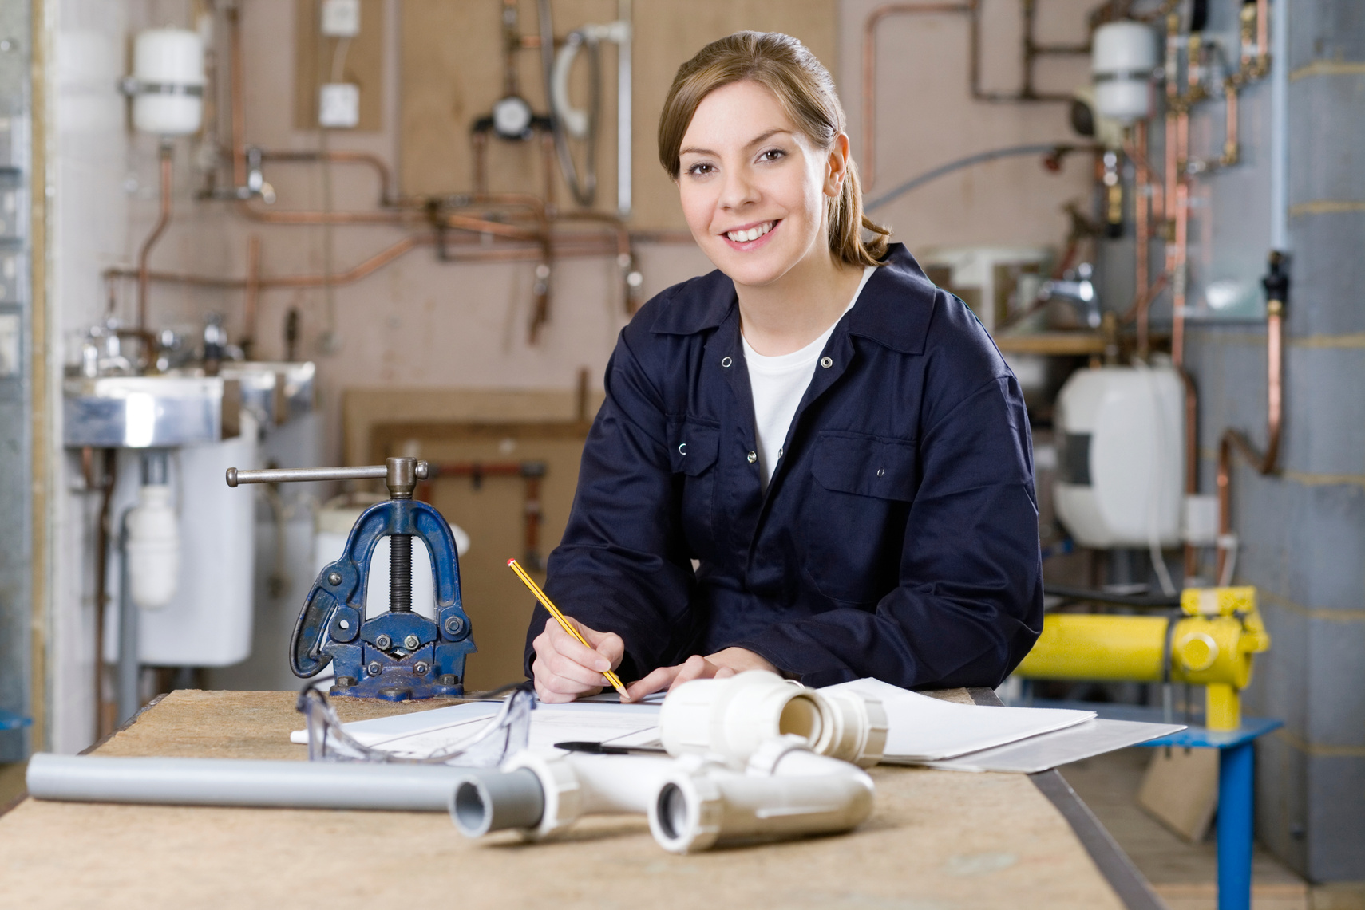
APPRENTICESHIPS AND TRADE SCHOOL
After high school or when you turn 18, you can enter an apprenticeship program or go to trade school. Apprenticeships combine classroom learning with hands-on experience, while trade school is a more traditional classroom setting. After completing your training, you can earn a license and start working as a professional plumber!
© 2026 Explore The Trades. All rights reserved.

Slide 7

WHAT CLASSES PREPARE YOU FOR A CAREER IN PLUMBING?
Math: Plumbers use algebra to calculate pipe flow and water pressure.
Physics: Plumbers understand the effect of temperature, pressure, and gravity on the flow of water.
Chemistry: Plumbers understand water quality and its effect on a plumbing system.
© 2026 Explore The Trades. All rights reserved.

Slide 8
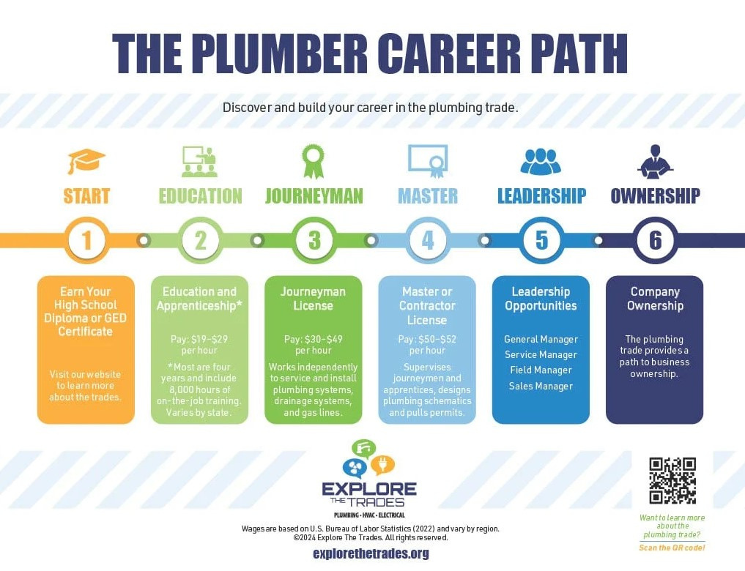
CAREER PATHWAYS
© 2026 Explore The Trades. All rights reserved.

Slide 9
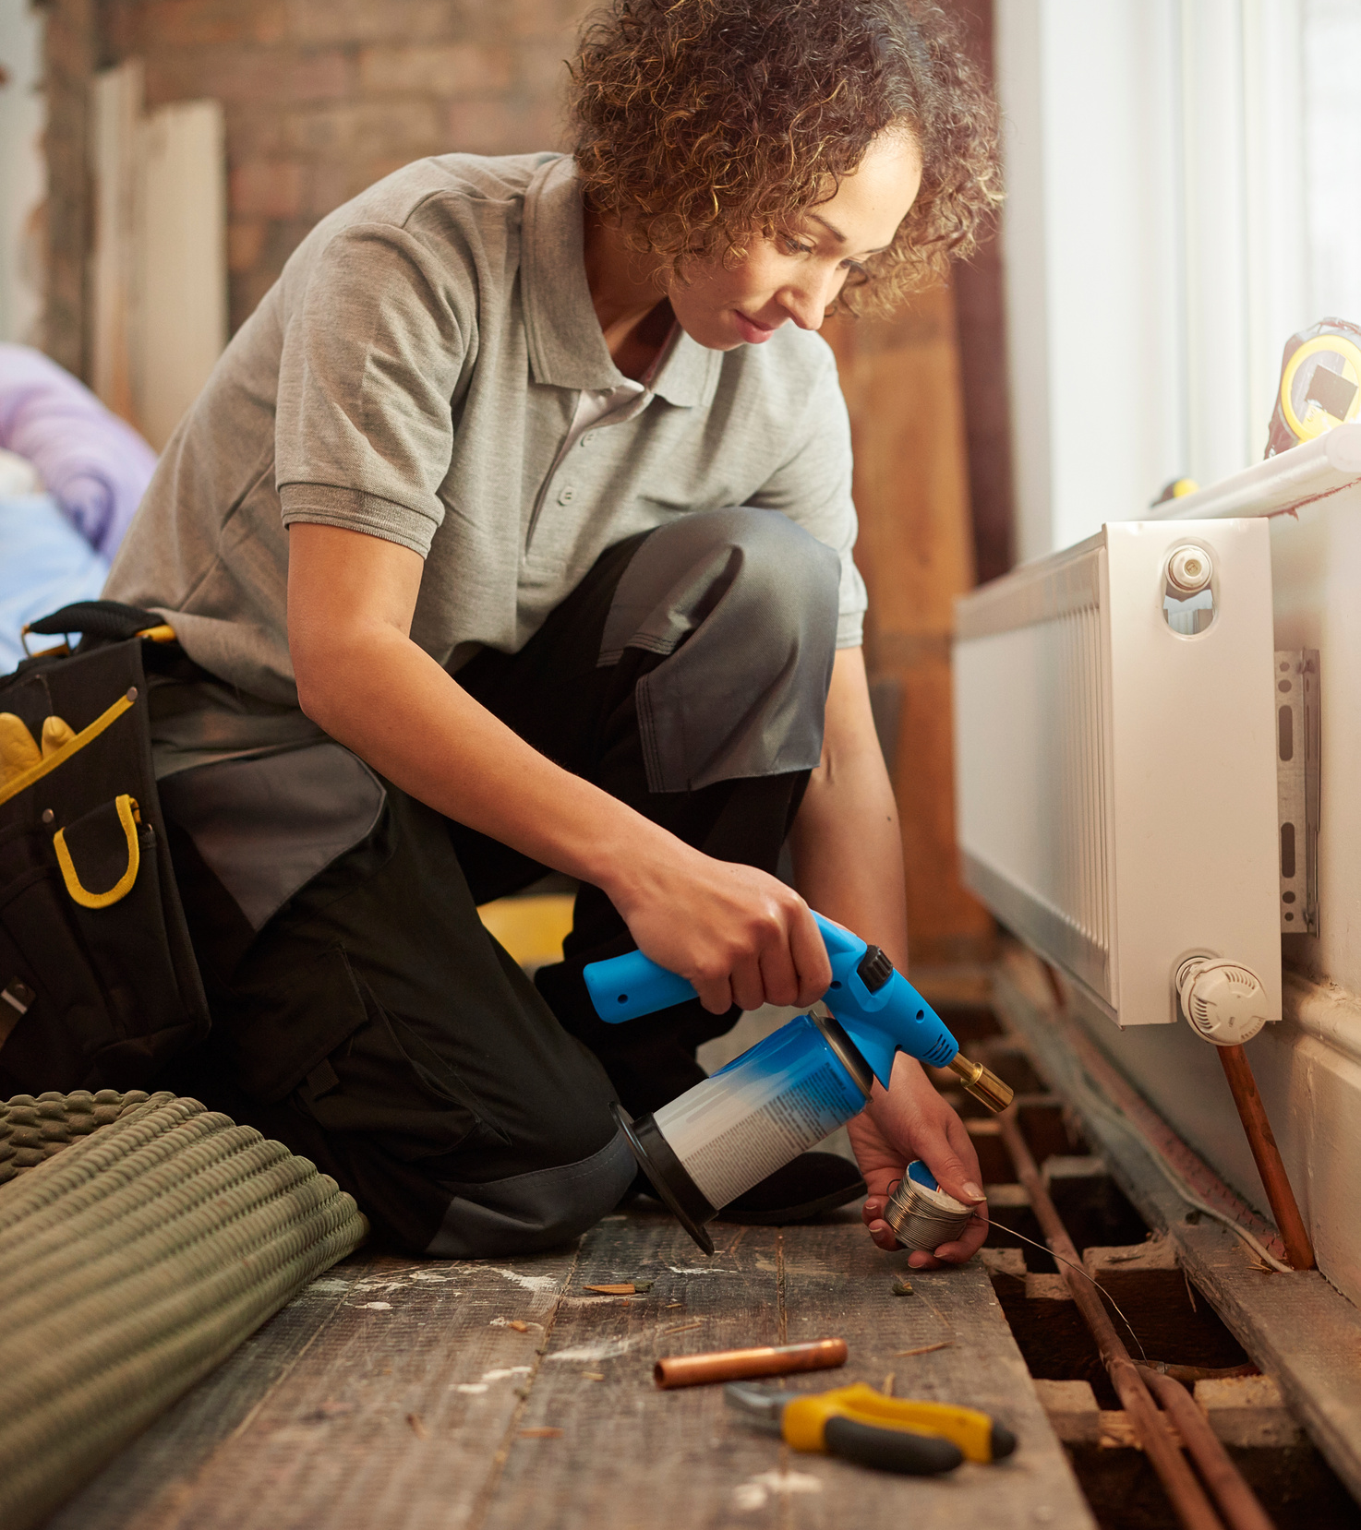
TYPES OF EMPLOYMENT
  Residential (single-family homes, apartments, townhouses)
  Industrial (power plants, factories, data centers)
  Commercial (hospitals, restaurants, office buildings)
  Agricultural (farms, greenhouses, barns)
© 2026 Explore The Trades. All rights reserved.

Slide 10
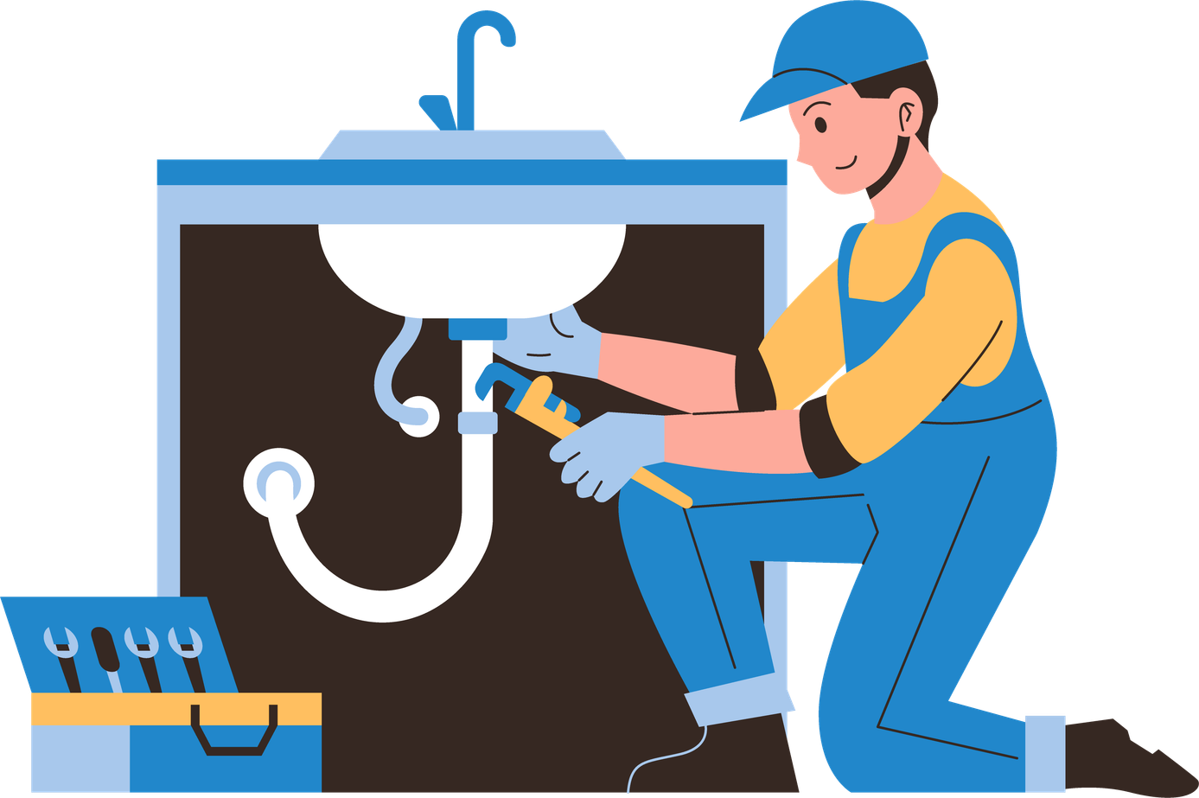
WHERE DO PLUMBERS WORK?
Indoors:
  Installing and repairing fixtures
  Working basements, bathrooms, and kitchens
  Maintaining water heaters and sump pumps
Outdoors:
  Repairing sewer and water lines
  Installing irrigation systems
  Working on septic tanks or storm drains
© 2026 Explore The Trades. All rights reserved.

Slide 11

PAY
  Pay varies by location and by experience.
  Starting out you can earn on average between $20 to $31 per hour. (U.S. Bureau of Labor Statistics, 2024)
© 2026 Explore The Trades. All rights reserved.

Slide 12

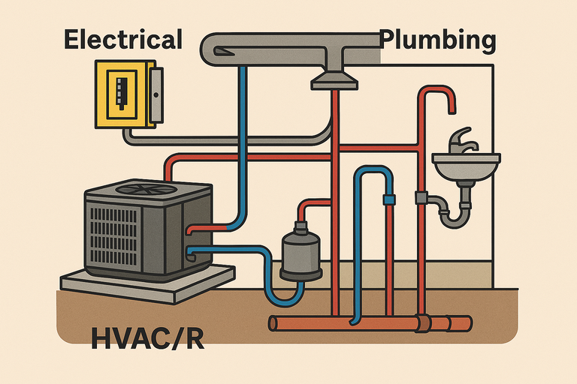
DID YOU KNOW?
Did you know that electrical systems, HVAC/R, and plumbing often work together?
HVAC/R units need electricity to run fans and compressors, and plumbing systems sometimes use electric pumps for water flow. Understanding how these systems connects makes plumbers valuable on construction and maintenance teams.
There are so many exciting options waiting for you in the trades!
© 2026 Explore The Trades. All rights reserved.

Slide 13






WANT TO LEARN MORE?
Check out our website, follow us on social media, or take our quiz today to see which trade fits you best
www.explorethetrades.org
Follow us on social media @explorethetrades

