Slide 1

Introduction to
HVAC

Slide 2
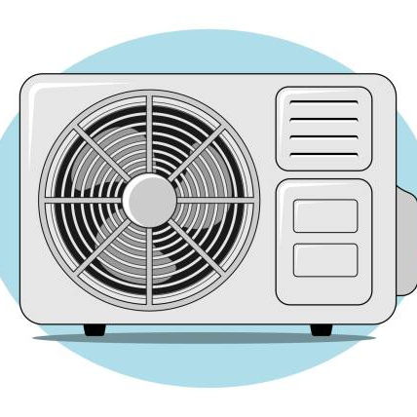
WHAT IS HVAC?
H - Heating
V - Ventilation
A - Air
C - Conditioning
© 2026 Explore The Trades. All rights reserved.

Slide 3
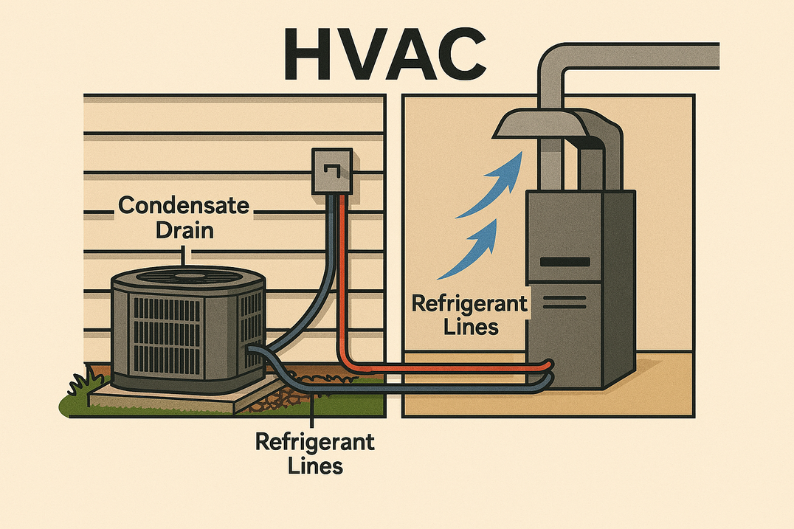
WHERE DO WE SEE HVAC IN EVERYDAY LIFE?
Homes
Schools
Hospitals
Stores
Restaurants
© 2026 Explore The Trades. All rights reserved.

Slide 4
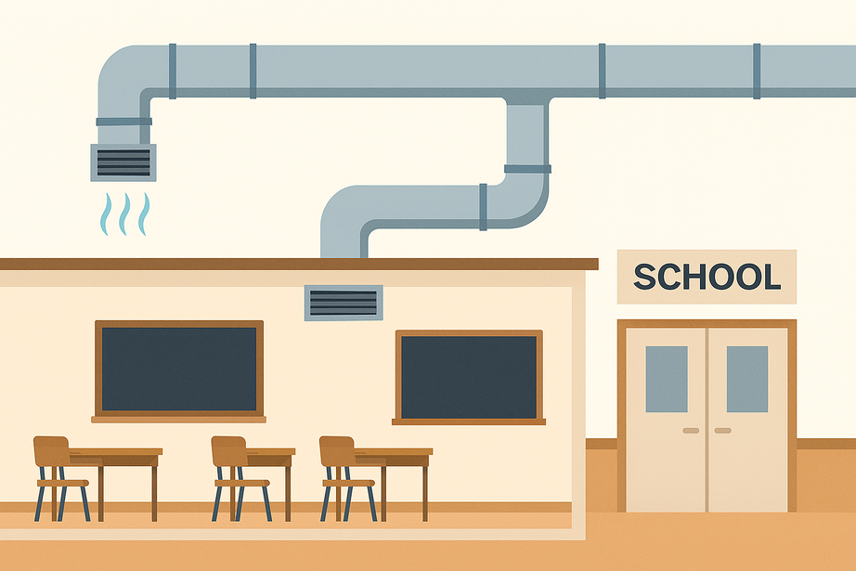
WHY IS HVAC IMPORTANT?
It helps control temperature
It helps control air quality
It helps control humidity
© 2026 Explore The Trades. All rights reserved.

Slide 5
WHY DO WE NEED HVAC?
Comfort: Keeps indoor spaces warm in the winter and cool in the summer.
Health: Filters air to remove dust, allergens, and pollutants.
Safety: Prevents overheating of equipment and controls humidity.
Food & Medicine: Refrigeration keeps food fresh and medicine safe.
© 2026 Explore The Trades. All rights reserved.

Slide 6
TRAINING
HVAC training programs can be taken during or after high school and earn certifications such as EPA 608 (which allows you to handle refrigerants) or NATE (North American Technician Excellence) which tests your understanding of installing, maintaining, and repairing HVAC systems.
© 2026 Explore The Trades. All rights reserved.

Slide 7
WHAT CLASSES PREPARE YOU FOR A
CAREER IN HVAC?
Math: HVAC technicians rely on math every day to:
Use geometry to design ductwork layouts and angles
Use formulas to help with heat load calculations and airflow
Convert units
Measure to calculate room size
© 2026 Explore The Trades. All rights reserved.

Slide 8
WHAT CLASSES PREPARE YOU FOR A CAREER IN HVAC?
Chemistry: HVAC technicians reply on chemistry every day to:
Understand how refrigerants change state (liquid to gas) to move heat
Understand combustion in furnaces, and the environmental impacts of refrigerants
What are refrigerants? They are special liquids or gases used in air conditioners, refrigerators, and heat pumps to move heat from one place to another.
© 2026 Explore The Trades. All rights reserved.

Slide 9
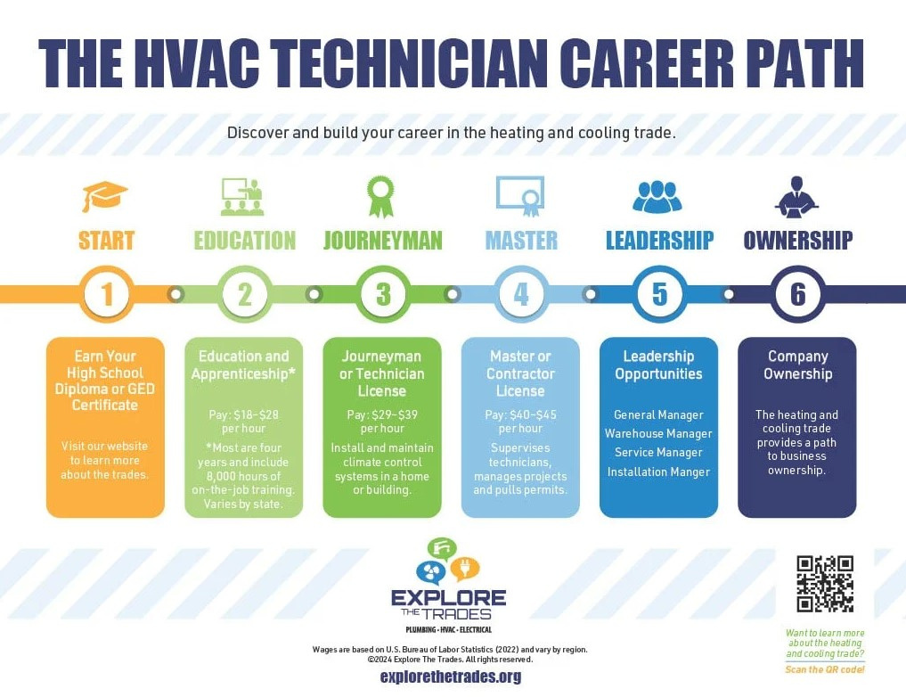
CAREER PATHWAYS
© 2026 Explore The Trades. All rights reserved.

Slide 10

TYPES OF EMPLOYMENT
Businesses that focus on residential homes
Businesses that focus on commercial buildings
Hospitals
School systems
Universities & colleges
Factories & warehouses
Data centers
© 2026 Explore The Trades. All rights reserved.

Slide 11
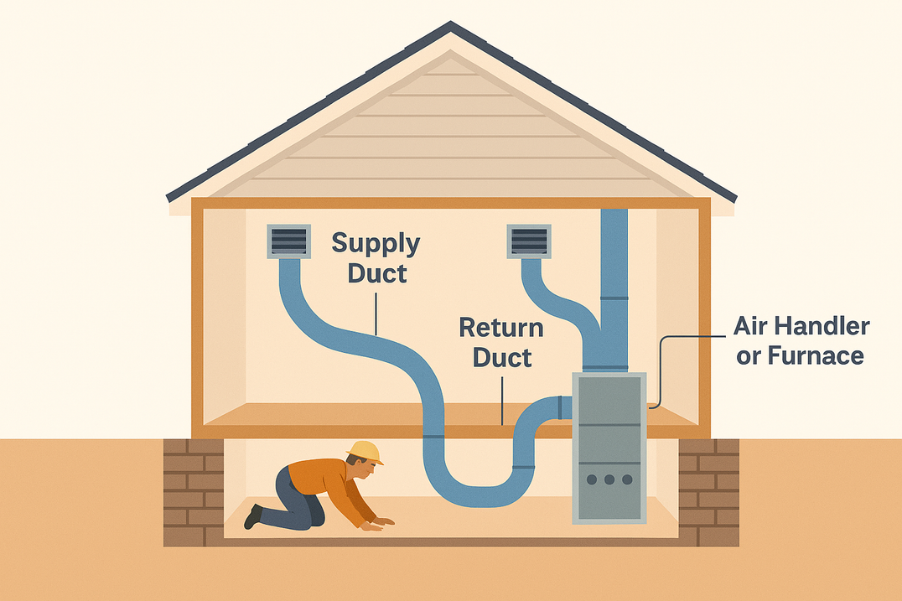
WHERE DO HVAC TECHNICIANS WORK?
Indoors:
Installing and repairing systems
Working basements, attics, mechanical rooms
Outdoors:
Fixing rooftop units or outdoor A/C units
Maintaining systems on building exteriors or in open areas
Running ductwork under houses
© 2026 Explore The Trades. All rights reserved.

Slide 12

PAY
Pay varies by location and by experience
Starting out you can earn on average between $18 to $28 per hour (U.S. Bureau of Labor Statistics, 2024)
© 2026 Explore The Trades. All rights reserved.

Slide 13

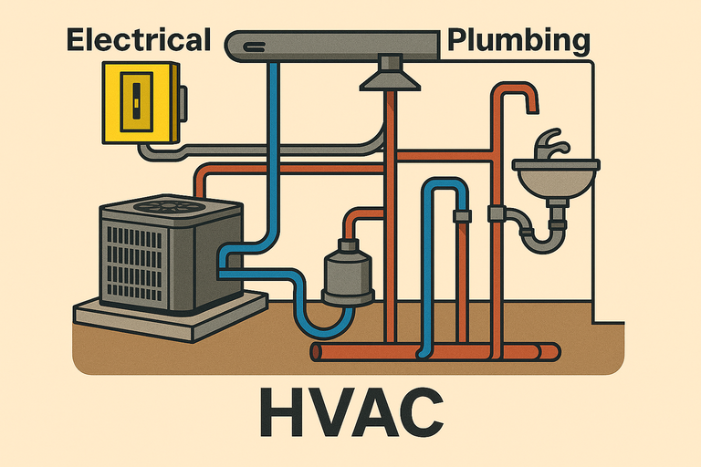
DID YOU KNOW?
Did you know that electrical systems, HVAC, and plumbing often work together?
HVAC units need electricity to run fans and compressors, and plumbing systems sometimes use electric pumps for water flow. Understanding how these systems connects makes HVAC technicians valuable on construction and maintenance teams.
There are so many exciting options waiting for you in the trades!
© 2026 Explore The Trades. All rights reserved.

Slide 14







WANT TO LEARN MORE?
Check out our website, follow us on social media, or take our quiz today to see which trade fits you best
www.explorethetrades.org
Follow us on social media @explorethetrades

